Slide 1
ZELO LAČNA GOSENICA
Eric Carle
Pripravila: Darja Dolenc

Slide 2
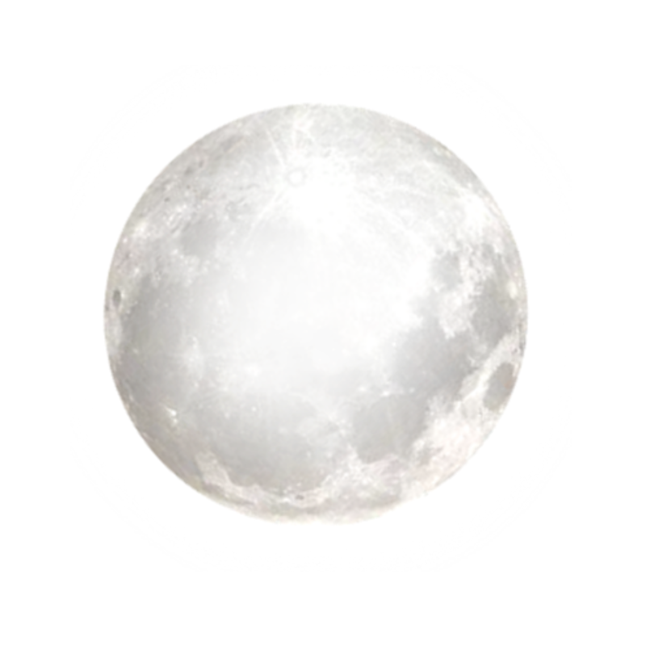
V SREBRNI MESEČINI JE NA LISTU LEŽALO DROBNO JAJČECE.

Slide 3
NEKEGA NEDELJSKEGA JUTRA JE VZŠLO SONCE IN – POP! – IZ JAJČECA JE PRILEZLA DROBCENA IN ZELO LAČNA GOSENICA.

Slide 4
TAKOJ JE PRIČELA ISKATI HRANO.

Slide 5
PONEDELJEK
V PONEDELJEK SE JE PREGRIZLA SKOZI JABOLKO – IN ŠE JE BILA LAČNA.

Slide 6
TOREK
V TOREK SE JE PREGRIZLA SKOZI DVE HRUŠKI – IN ŠE JE BILA LAČNA.

Slide 7
SREDA
V SREDO SE JE PREGRIZLA SKOZI TRI SLIVE– IN ŠE JE BILA LAČNA.

Slide 8
ČETRTEK
V ČETRTEK SE JE PREGRIZLA SKOZI ŠTIRI JAGODE – IN ŠE JE BILA LAČNA.

Slide 9
PETEK
V PETEK SE JE PREGRIZLA SKOZI PET POMARANČ– IN ŠE JE BILA LAČNA.

Slide 10
SOBOTA
V SOBOTO PA SE JE PREGRIZLA SKOZI KOŠČEK ČOKOLADNE TORTE, SKOZI SLADOLED PA SKOZI KUMARICO

Slide 11
IN KOS SIRA, SKOZI SALAMO, LIZIKO, ČEŠNJEVO PITO IN KLOBASO, SKOZI KOLAČEK, IN ŠE LUBENICO.

Slide 12
NEDELJA
NASLEDNJI DAN JE BILA ZOPET NEDELJA. GOSENICA SE JE PREGRIZLA SKOZI LEP ZELEN LIST IN ZELO JI JE ODLEGLO.

Slide 13
ZDAJ NI BILA VEČ LAČNA IN NIČ VEČ MAJHNA. BILA JE VELIKA DEBELA GOSENICA.

Slide 14
OKROG SEBE JE SPREDLA MAJHNO HIŠKO, BUBO. V NJEJ JE OSTALA DVA DOLGA TEDNA. NATO PA JE V STENI BUBE PREGRIZNILA LUKNJICO, ZLEZLA VEN IN…

Slide 15
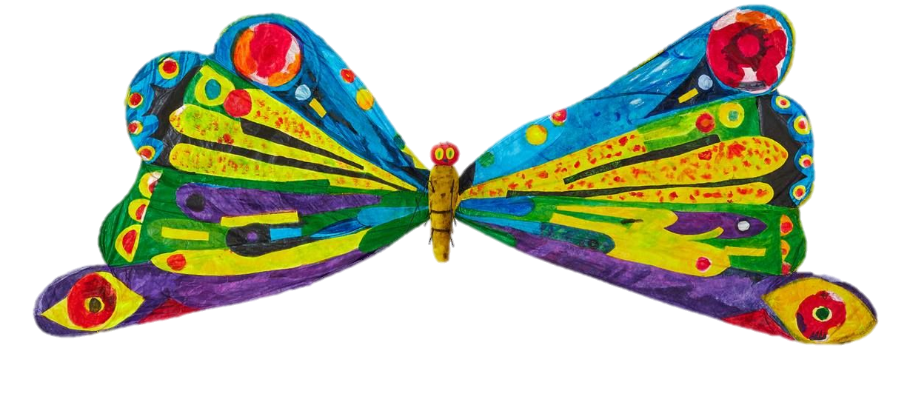
BILA JE PRELEP METULJ.

Slide 16
VIRI SLIK
https://www.pngfind.com/pngs/m/397-3972363_soil-vector-pile-star-hd-png-download.png
https://clipartart.com/images/clipart-green-leaves-1.png
https://img.clipartlook.com/leaf-clip-art-clipart-leaf-2504_3500.png
https://i.pinimg.com/originals/d8/6b/da/d86bda4ebc2e5dda5c3b1fd6de2e181c.png
https://www.pngitem.com/pimgs/m/75-757665_larva-very-hungry-caterpillar-transparent-hd-png-download.png
https://i.pinimg.com/originals/7e/28/89/7e288947c2c179f39398a72fdad19e0c.png
https://toppng.com/uploads/preview/transparent-background-sun-clipart-11563032022om1hqfixnw.png
https://www.pngitem.com/pimgs/m/50-507591_cloud-png-clip-arts-transparent-background-rain-clipart.png
https://2.bp.blogspot.com/-JTgE0SUZJj8/T8Ec3Wp-79I/AAAAAAAAQ2I/rPof-nyHuw8/s640/Enzo_Mari_La_Mela%C2%A9nova68.com.jpg
https://easydrawingart.com/wp-content/uploads/2019/07/how-to-draw-a-pear.jpg
https://www.pngitem.com/pimgs/m/280-2809301_plum-clipart-hd-png-download.png
https://cdn1.vectorstock.com/i/1000x1000/05/55/fresh-strawberry-clipart-vector-9730555.jpg
https://www.netclipart.com/pp/m/8-80981_orange-clip-art-free-free-clipart-images-orange.png
https://cdn.clipart.email/99723ec0774122c1a4ea73f00c13fec5_best-slice-of-cake-illustrations-royalty-free-vector-graphics-_612-612.jpeg
https://clipartart.com/images/99-ice-cream-clipart-7.png
https://lh3.googleusercontent.com/proxy/TDtnROdbDo88StIkid8fEpCtdBJEkNCKTXCsda9lKCig2mnHqbARlF_pkr4X2fnufmi8iR8a5e02e3PT95dhazX6f3MG26WztQ
https://mpng.subpng.com/20180323/ayw/kisspng-macaroni-and-cheese-clip-art-cheese-5ab4c2ad210c57.1469319415217957571354.jpg
https://www.pinclipart.com/picdir/middle/222-2229425_vector-illustration-of-salami-cured-sausage-fermented-clipart.png
https://www.epicentrofestival.com/wp-content/uploads/2019/12/Lollipop-Lollipop-Clipart-720x1021.jpg
https://i.pinimg.com/originals/a1/f5/46/a1f5468dd06812b62f7c27a6ed86f9a1.jpg
https://www.pngitem.com/pimgs/m/70-704621_cartoon-sausage-clipart-sausage-png-transparent-png.png
https://www.kindpng.com/picc/m/8-86823_cupcake-free-to-use-clip-art-cup-cake.png
https://i.pinimg.com/736x/e9/d3/ff/e9d3ffb8c043c0030656beb8a2ea3105.jpg
https://clipartart.com/images/butterfly-eric-carle-clipart-3.jpg

